Slide 1
The Smart Ambulance Services
PIP104 University Project-II
Review-1
Batch Number: CSE-G 186
Roll Number | Student Name
2O2O1CSE0677 | H DILEEP
20201CSE0681 | AKSHAY M
20201CSE0710 | MAHESH
20201CSE0689 | PRASHANTH S H
Under the Supervision of,
Mr. Prakash.B.Metre
Assistant Professor
School of Computer Science & Engineering
Presidency University - Bangalore

Slide 2
Abstract:
Enhancing Emergency Medical Response:
Smart ambulance services are a revolutionary approach to improving emergency medical response.
Traffic Management Integration:
Integration with traffic management systems helps ambulances navigate through congested areas more efficiently.
Reduced Human Errors:
Automation and technology reduce the risk of human errors in the ambulance service.
Cost Savings:
Improved efficiency can lead to cost savings in the healthcare system.
Real-Time Location Tracking:
Smart ambulances are equipped with GPS systems for real-time tracking and precise location identification.
Faster Response Times:
The use of technology allows for quicker dispatch and route optimization, reducing response times.

Slide 3
Literature Survey :
Paper Name: Towards Vehicular Sensor Networks with Android Smartphones for Road Surface Monitoring.
Authors: Girts Strazdins, Artis Mednis, Georgijs Kanonirs, Reinholds Zviedris and Leo Selav
Description: Android is one of the most popular smartphone platforms at the moment, and the popularity is even rising. Additionally, it is one of the most open and flexible platforms providing software developers easy access to phone hardware and rich software API. We envision Android-based smartphones as a powerful and widely used participatory sensing platform in near future. In this paper we examine Android smartphones in the context of road surface quality monitoring. We evaluated a set of pothole detection algorithms on Android phones with a sensing application while driving a car in urban environment.

Slide 4
Paper Name: Development of the Traceability System which Secures the Safety of Fishery Products using the QR Code and a Digital Signature
Authors: Katsunori Seino’, Shinji Kuwabara’, Sadayoshi Mikami2, Yuta Takahashi’, Mayumi Yoshikawa’, Hideto Narumi3, Kiyoto Koganezaki3, Takashi Wakabayashi4, Akira Nagano’
Description: Technologies that enable traceability for fishery products are increasing their demands. Recently proposed technologies are mainly based on disposal RF(IC) tags which are able to record information directly onto them. However, the current systems based on RF tags have problems of expensive price of tags, and weakness of reading information if applied onto surface of products containing much water, which prevents to construct practically feasible systems using the RF tags.

Slide 5
Paper Name: Accident identification system with SMS notification
Authors: Supriya vidhate, mamta tadavi, manisha jagtap, rajratan janrao
Description: In today’s world highway accident have become a common occurrence. Many people die each year due improper medical care after the accident happen. There is no effective method by which the correct authorities can be informed in time so that the person’s life can be saved. We are designing such a device which will not only detect any accident that happens to the car but also inform the appropriate authorities immediately as soon as the accident occurs

Slide 6
Paper Name: Applying QR Code and Mobile Application to Improve Service Process in Thai Hospital
Authors: Chayakrit Charoensiriwath, Navaporn Surasvadi, Suporn Pongnumkul, Thunyasit Pholprasit
Description: Hospital overcrowding has been a problem in Thai public healthcare system. The main cause of this problem is the limited available resources, including a limited number of doctors, nurses, and limited capacity and availability of medical devices. There have been attempts to alleviate the problem through various strategies.

Slide 7
Paper Name: Cloud Computing and Accident Handling Systems
Authors: Jabar H Yousif, Dinesh Kumar Saini
Description: An attempt is made to study the current issues of the cloud computing solutions for the life critical system- car accident systems in the Gulf region. Gulf region has high death rate because of car accidents and there is little or no proper accident handling facilities in the region.

Slide 8
Paper Name: Assessment of medication adherence app features, functionality, and health literacy level and the creation of a searchable Web-based adherence app resource for health care professionals and patients.
Authors: Seth Heldenbrand*, Bradley C. Martin, Paul O. Gubbins, Kristie Hadden, Catherine Renna, Rebecca Shilling, Lindsey Dayer
Description: Objectives: To assess the features and level of health literacy (HL) of available medication adherence apps and to create a searchable website to assist health care providers (HCP) and patients identify quality adherence apps. Practice description: Medication nonadherence continues to be a significant problem and leads to poor health outcomes and avoidable health care expense.

Slide 9
Paper Name: Recommendations of the DG eCall for the introduction of the pan-European eCall
Authors: eCall Driving Group
Description: With fatalities on the road across the EU of more than 40.000 people every year, the European Commission recognizes that the current measures towards reducing the fatality number is not enough. In the White Paper on European transport police from 2001, the European Commission proposed that the European Union should set itself the target of halving the number of road fatalities by 2010. One of the initiatives from the European Commission is the establishment of the eSafety Forum, which is a joint industry/public initiative for improving road safety by using new Information and Communications Technologies.

Slide 10
Paper Name: Towards Vehicular Sensor Networks with Android Smartphones for Road Surface Monitoring.
Authors: Girts Strazdins, Artis Mednis, Georgijs Kanonirs, Reinholds Zviedris and Leo Selavo
Description: Android is one of the most popular smartphone platforms at the moment, and the popularity is even rising. Additionally, it is one of the most open and flexible platforms providing software developers easy access to phone hardware and rich software © 2020 IJRTI | Volume 5, Issue 6 | ISSN: 2456-3315 IJRTI2006003 International Journal for Research Trends and Innovation (www.ijrti.org) 10 API.

Slide 11
Paper Name: Providing Accident Detection in Vehicular Networks Through OBD-II Devices and Android-based Smartphones.
Authors: Jorge Zaldivar, Carlos T. Calafate, Juan Carlos Cano, Pietro Manzoni
Description: By combining smartphones with existing vehicles through an appropriate interface we are able to move closer to the smart vehicle paradigm, offering the user new functionalities and services when driving. In this paper we propose an Android based application that monitors the vehicle through an On Board Diagnostics (OBD-II) interface, being able to detect accidents.

Slide 12
Paper Name:GPS based tracking and health parameter detection.
Authors: Shivali Walvekar and Kinjal More
Description: It displays the current location of ambulances and patient’s health parameter on the LCD display and sends that information to the hospital

Slide 13
Paper Name:Intelligent accident detection and RF communication.
Authors: Bhandari Prachi, Dalvi Kasturi and Chopade Priyanka
Description:It’s a web based application that shows the nearest ambulances, clinic and pharmacies to the user. The sensors placed in the vehicles helps in automatic accident detection and inform it the ambulance.

Slide 14
Objectives:
Improve ambulance service response times.
Optimize resource allocation for faster dispatch.
Enhance user satisfaction and accessibility.
It is a user-friendly mobile applications.
Establish a cost-effective and efficient model

Slide 15
Existing Methods & Drawbaks:
Traffic Monitoring Through GPS:
The GPS system of these smart ambulances is upgraded enough to fetch the real-time data from the traffic management authorities.
RFID Technology:
Besides this, these ambulances are utilizing the RFID technology for automated updates regarding inventory and medical consumables.
IOT:
The Internet of Things, or IoT, is a network of physical devices. These devices can transfer data to one another without human intervention. IoT devices are not limited to computers or machinery
Drawback:
There are some challenges awaited after the practical implementation of this idea of smart ambulances. The foremost is the security of the data, including patients’ profile, shared between the doctor and the patients.

Slide 16
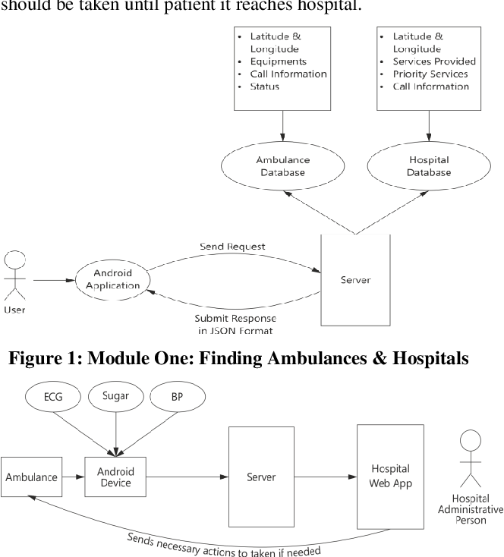
Architecture:

Slide 17
Methodology
Project Initiation:
Define the project scope, objectives, and goals.
Establish a project team and leadership.
System Design and Architecture:
Define the architecture of the smart ambulance system, including hardware, software, and communication components.
Technology Selection and Procurement:
Choose and procure the necessary technology components, such as IoT sensors, GPS devices, telemedicine equipment, and communication systems.
Software Development:
Develop software for dispatch, routing optimization, patient monitoring, and communication.
User Interface Design:
Design user-friendly interfaces for the mobile app and ambulance equipment.
Real-time data analysis:
predictive modeling will drive efficient ambulance dispatch, resource allocation, and routing. Rigorous testing and feedback loops will refine the system.

Slide 18
Timeline of Project
Project Initiation (Month 1-2)
Define project goals and objectives.
Identify key stakeholders and form a project team.
Secure funding and resources.
Market Research and Analysis (Month 3-4)
Conduct market research to understand the current ambulance service landscape.
Identify competitors and potential partners.
Determine target regions and demographics.
Concept and Requirements (Month 5-6)
Develop a concept for the smart ambulance service.
Define the technical and functional requirements.
Create a preliminary budget and project plan.
Technology Selection and Procurement (Month 7-8)
Choose the necessary hardware and software components.
Procure or develop the technology required for the service.
System Design and Development (Month 9-12)
Develop the smart ambulance service infrastructure.
Create a mobile app or web portal for users.
Integrate real-time tracking, communication, and data analysis features.
Perform initial testing and quality assurance.

Slide 19
Expected Outcomes
We expect that after our project, people will get help from ambulances faster, making them safer. The system will be easier to use, so anyone can book an ambulance quickly. It will also help ambulance drivers find the fastest way to reach people.
Overall, our project aims to make ambulance services better and more helpful to everyone.

Slide 20
Conclusion
In conclusion, this project seeks to enhance ambulance booking services by addressing existing shortcomings and introducing innovative solutions. By reducing response times, minimizing errors, and improving the user experience, we aim to create a more efficient and effective system. Our work has the potential to significantly impact emergency healthcare and public safety.

Slide 21
References
https://www.tutorialspoint.com/index.htm
https://ieeexplore.ieee.org/document/9609423/
https://nevonprojects.com/emergency-ambulance-booking-android-app/
https://www.researchgate.net/publication/342154636_Ambuitec_Ambulance_Booking_Application_for_Emergency_Health_Response_Blood_Inventory
https://www.studocu.com/in/document/sant-gadge-baba-amravati-university/project-report/ambulance-booking-app/20584474

Slide 22
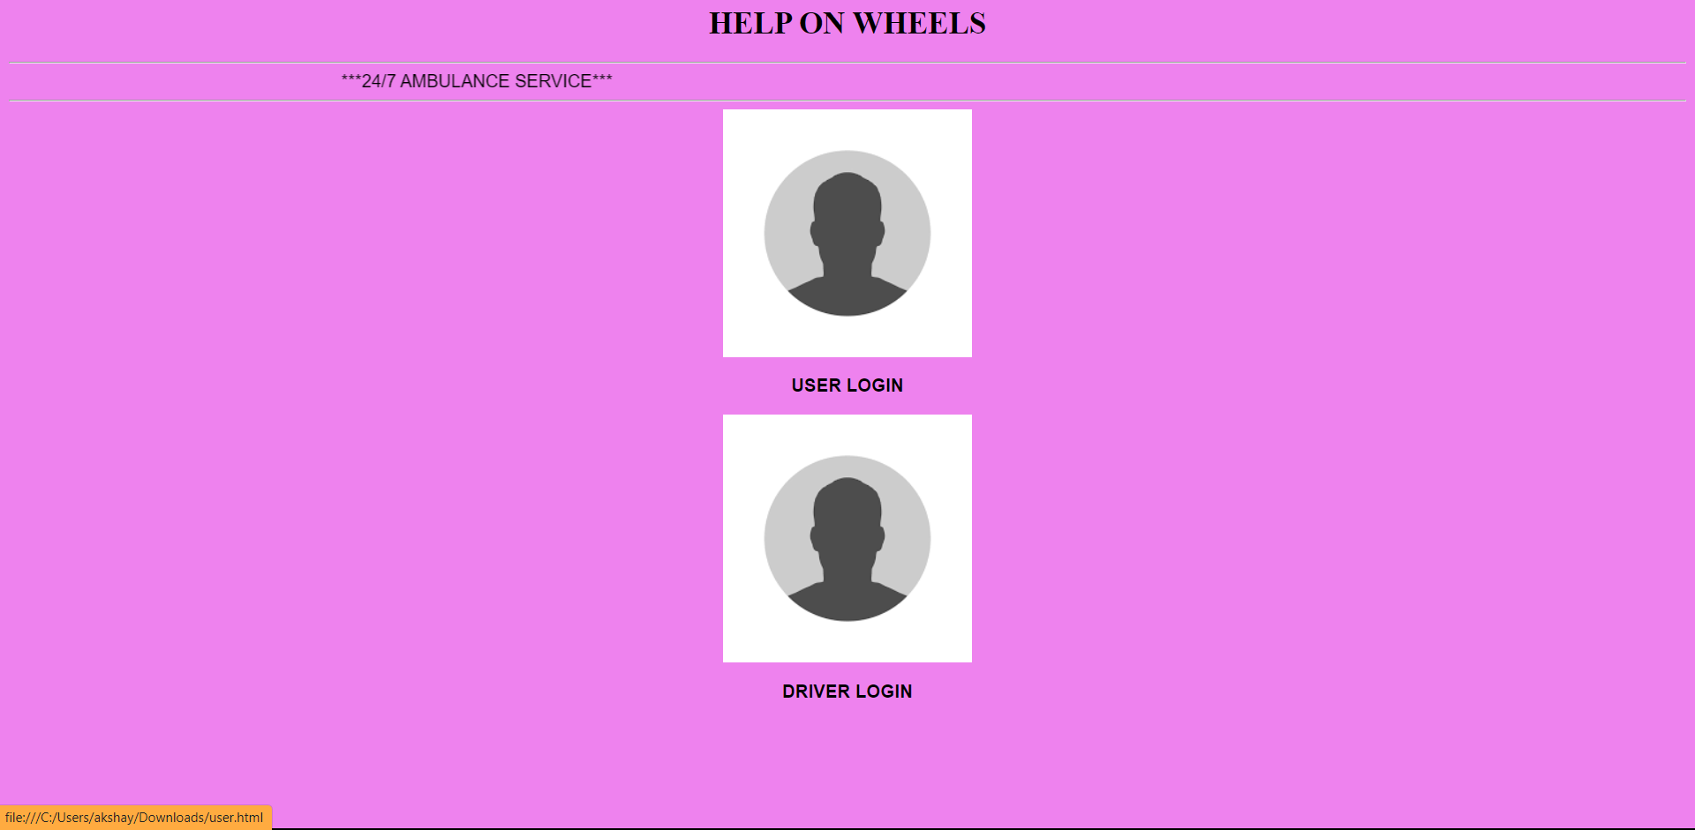
HELP ON WHEELS(HOW)

Slide 23
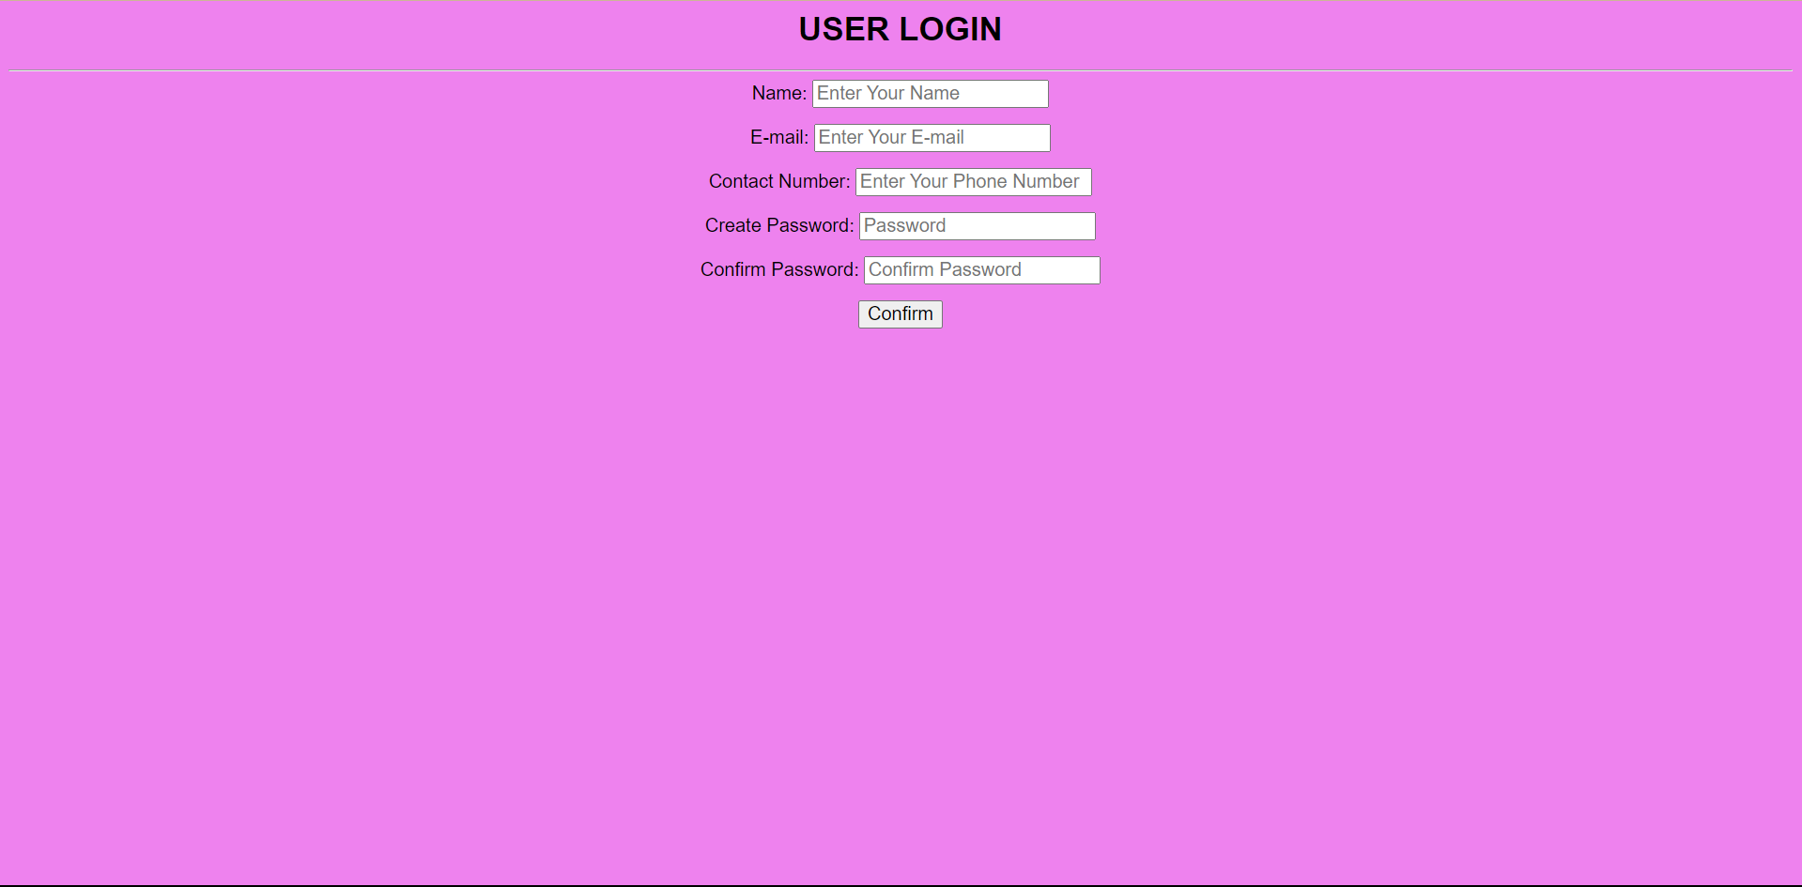
USER INTERFACE

Slide 24
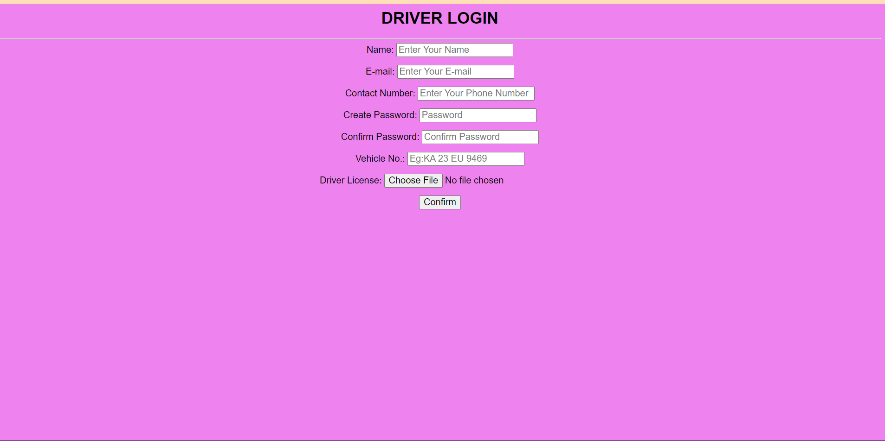
DRIVER INTERFACE

Slide 25
THANK YOU

